Slide 1
Laboratory Medicine Core Data Analysis
Lesson 5
Summarize Data

Slide 2
Objectives
Be able to…
Summarize variables, including calculation of summary statistics
Break apart data frames observations into groups
Combine grouping and summarization to quickly calculate basic statistics for subgroups

Slide 3
Typical Data Science Pipeline
From R for Data Science (https://r4ds.had.co.nz/introduction.html)
Notes:
In this session we will focus on modeling. But, in the process, we will do a lot more data transformation

Slide 4
Summarize()

Slide 5
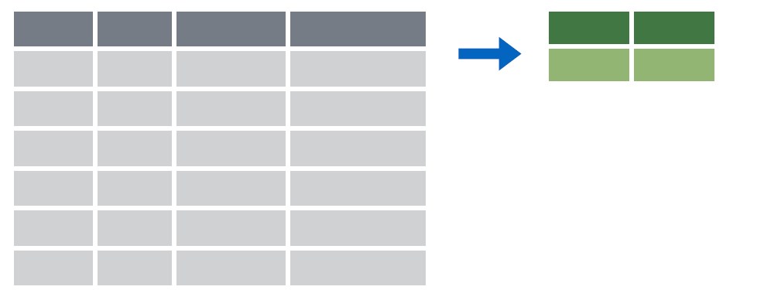

summarize()
Make summaries of your data
Notes:
Apply a function (or functions) to all observations of a variable and return a single value, or summary.

Slide 6
summarize()
Make summaries of your data
orders %>%
summarize(new_variable = calculation)
name for new variable
Value or function

Slide 7
summarize()
function that returns number of observations
Make summaries of your data
orders %>%
select(order_id, patient_id) %>%
head(4) %>%
summarize(order_count = n())
order_id | patient_id
19766 | 511388
88444 | 511388
40477 | 508061
97641 | 508061
order_count
4
Notes:
n() returns the number of observations or rows for a data frame.
Note, that to simplify the data frame, we first will select 2 variables and include the first 4 observations.

Slide 8
summarize()
function that returns number of distinct values
Make summaries of your data
orders %>%
select(order_id, patient_id) %>%
head(4) %>%
summarize(order_count = n(),
pt_count = n_distinct(patient_id))
order_id | patient_id
19766 | 511388
88444 | 511388
40477 | 508061
97641 | 508061
order_count
4
pt_count
2
Notes:
n_distinct() counts the number of distinct, or unique, observations. So, while there are 4 rows, there are only 2 distinct patient_id’s.

Slide 9
Your Turn 1
Add onto the code in the above chunk to calculate:
a) Mean count of orders per patient
b) Mean count of orders per department

Slide 10
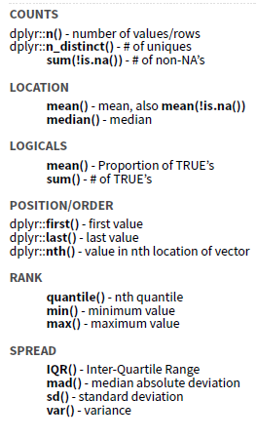
Notes:
There are many native summary functions from base R and dplyr.

Slide 11
Your Turn 2
Use summarize() to calculate:
a) The date of the first (or minimum) order
b) The median time difference between order_time and result_time
*Hint* Refer to help for NA handling
Notes:
The result_time is missing for some orders, presumably because the tests were never resulted. Missing data, indicated as NA, can be really important. Ignoring missingness can lead to incorrect interpretation due to implicit bias. Some functions will automatically throw out missing data, and just print a warning, like ggplot functions. However, others will throw and error or return NA. This can be annoying, because it creates extra work. But, it is a much safer practice, because it forces you to explicitly handle missing data.

Slide 12
Your Turn 3
Consider:
How would you calculate the median number of orders for each patient?
Notes:
The mean was a special case, because it can be calculated using summarize and not explicitly knowing which order is from which patient. But, to calculate the median (find the mid-point of the observations), we need to be able to assess each patient’s observations separately.

Slide 13
group_by()

Slide 14
group_by()
Notes:
Group_by is a challenging function to master, but extremely powerful. It is one of those tools that once you understand how to use, you cannot possibly go back to live without it.
The idea is simple. I have one big data frame and I want to break the observations up into several groups. Then, I’m going to “look at” those groups separately.

Slide 15
group_by()
Grouping observations based on a specific variable’s values
orders %>%
group_by(variable)
name of variable to group by

Slide 16
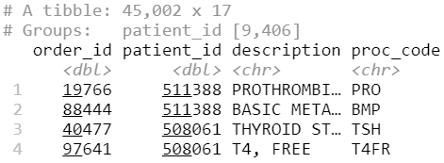
group_by()
Group observations by patient_id
orders %>%
group_by(patient_id)
Notes:
We can see that the resulting object has 45,002 rows that are broken up into 9,406 groups. Inherently, this means there are 9,406 distinct patient_id. Some of these groups will have a single observation. Many of these groups will have more than one observation.

Slide 17
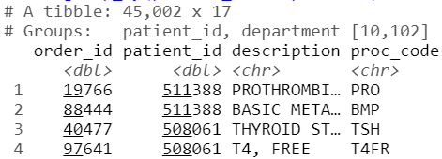
group_by()
Group observations by patient_id and department
orders %>%
group_by(patient_id, department)
Notes:
Here we are defining each group using two variables. So, each group has a unique combination of patient_id and department. This data frame has 9,406 distinct patient_id’s and 20 distinct department’s. Theoretically, we could have 9,406 * 20 = 188,120 different groups. But, there are only 10,102 groups. group_by only includes groups that are present in the data frame. It appears that in our dataset most patients are only seen in a single department, so the vast majority of theoretical patient_id-department combinations have no observations.

Slide 18
group_by() %>% summarize()

Slide 19
group_by()
%>%
summarize()
Make summaries of your data by group
Notes:
Just like we can apply summarize() to a full data frame, we can apply summarize() to each group separately.

Slide 20
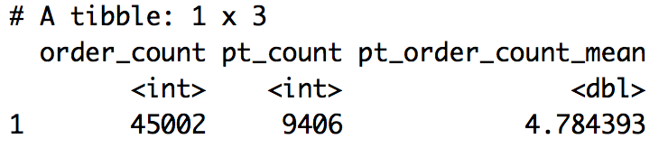
Re-calculate the mean order count per patient
Recall that we previously used summarize() and mutate() like this:
orders %>%
summarize(order_count = n(),
pt_count = n_distinct(patient_id)) %>%
mutate(pt_order_count_mean = order_count / pt_count)
Notes:
This worked for mean, because we did not need to separate out observations by patient to calculate the mean.

Slide 21
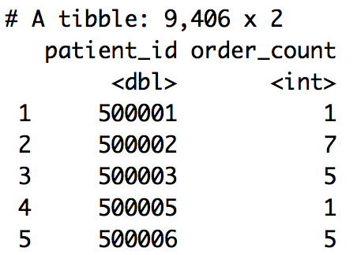
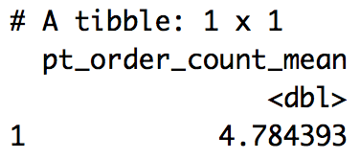
Calculate the mean order count per patient
Let’s now use group_by() and summarize()…
orders %>%
group_by(patient_id) %>%
summarize(order_count = n()) %>%
summarize(pt_order_count_mean = mean(order_count))
1
2
1
2
Notes:
Here we are nesting two levels of summarization. This can be confusing, so it is useful to walk through step-by-step. The first summarization is applied to each patient separately (groups separately). The second summarization is applied to the full data frame and summarizes the (patient) summary.

Slide 22
Your Turn 4
Calculate:
a) The median number of orders per patient
b) The maximum number of TSH orders per patient
c) (*Bonus*) The 5th and 95th percentile of the number of orders per patient (Hint: look up function `quantile()`)

Slide 23
Your Turn 5
Calculate the mean order count per patient for each department
Hint: summarize() rolls up a single grouping variable at a time

Slide 24
Objectives
Be able to…
Summarize variables, including calculation of summary statistics
Break apart data frames observations into groups
Combine grouping and summarization to quickly calculate basic statistics for subgroups

